Slide 1



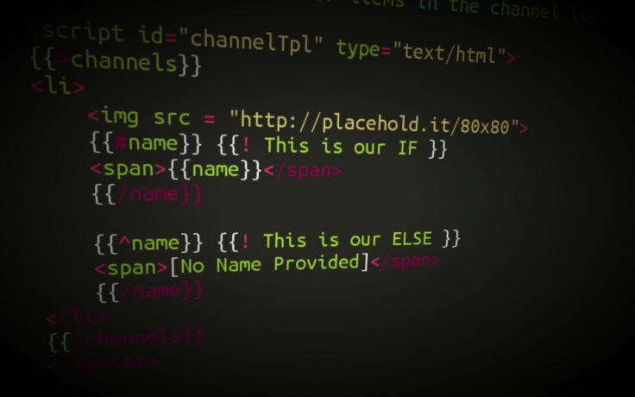

Templating, Routing
Extending functionality
using Collections
JS Apps
SoftUni Team
Technical Trainers
Software University
http://softuni.bg

Slide 2

Table of Contents
What is Sammy.js?
Create custom URLs
Using HTML templates with Mustache.js

Slide 3
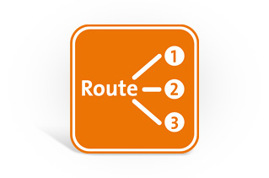
Application routing
Defining URL structure of app

Slide 4

What is Sammy.js?
JavaScript framework providing:
Routes – defining the basic structure of RESTful your application
Events – creating custom events implementing some logic
Well suited for building simple RESTful applications
Using JSON data stores

Slide 5

Installing sammy.js
Download sammy.js from http://sammyjs.org/download
Include it in your project
Place sammy.js after jQuery
Create routes for your application

Slide 6

Application routing
Live Demo

Slide 7

HTML Templating
Fill HTML templates with data

Slide 8

What is Mustache.js?
Logic-less templates:
Used for HTML, config files, source code – anything
Logic-less – does not contain if-else statements or loops.
Entirely defined by tags.
Runs on many languages like: Ruby, Python, JavaScript, PHP, Perl etc.

Slide 9
Installing mustache.js
Download mustache.js from https://github.com/janl/mustache.js
Include it in your project
Place mustache.js after jQuery
Create templates for your application

Slide 10
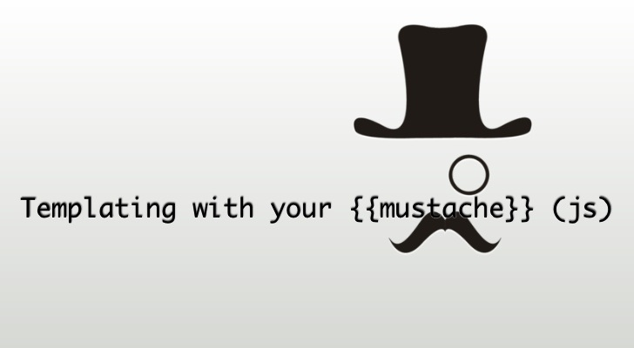
HTML Templating
Live Demo

Slide 11








Templating and Routing
https://softuni.bg/courses/javascript-applications/

Slide 12
License
This course (slides, examples, demos, videos, homework, etc.) is licensed under the "Creative Commons Attribution-NonCommercial-ShareAlike 4.0 International" license
Attribution: this work may contain portions from
"JavaScript Applications" course by Telerik Academy under CC-BY-NC-SA license

Slide 13





Free Trainings @ Software University
Software University Foundation – softuni.org
Software University – High-Quality Education, Profession and Job for Software Developers
softuni.bg
Software University @ Facebook
facebook.com/SoftwareUniversity
Software University @ YouTube
youtube.com/SoftwareUniversity
Software University Forums – forum.softuni.bg

